Slide 1
Models of Communication

Slide 2
Linear Communication Model
communication is considered one way process where sender is the only one who sends message and receiver doesn’t give feedback or response. The message signal is encoded and transmitted through channel in presence of noise. The sender is more prominent in linear model of communication.

Slide 3
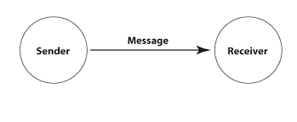

Slide 4
Interactive Communication Model
deals with exchange of ideas and messages taking place both ways from sender to receiver and vice-versa. The communication process take place between humans or machines in both verbal or non-verbal way.

Slide 5
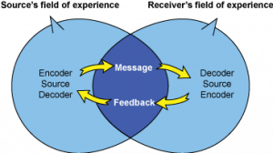

Slide 6
Osgood and Schramm
circular Model
It can happen within our self or two people; each person acts as both sender and receiver and hence use interpretation. It is simultaneously take place e.g. encoding, interpret and decoding.
Semantic noise is a concept introduced here it occurs when sender and receiver apply different meaning to the same message. It happens mostly because of words and phrases for e.g. Technical Language, So certain words and phrases will cause you to deviate from the actual meaning of the communication.

Slide 7
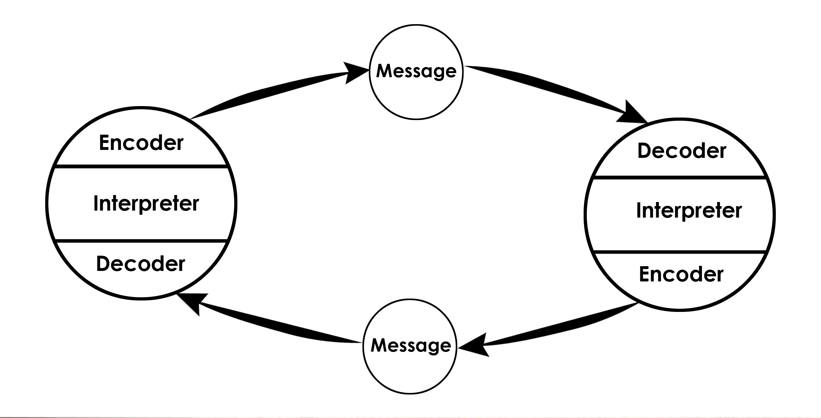

Slide 8
Transactional Model
the process of continuous change and transformation where every component is changing such as the people, their environments and the medium used. Due to this, it assumes the communicators to be independent and act any way they want.

Slide 9
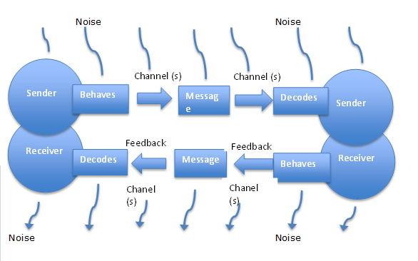

Slide 10
helical Model
Helical model of communication introduces the concept of time where continuousness of the communication process and relational interactions are very important. Communication is taken as a dynamic process in helical model of communication and it progresses with age as our experience and vocabulary increases.
At first, helical spring is small at the bottom and grows bigger as the communication progresses. The same effect can be seen with communication of humans, where you know nothing about a person at first and the knowledge grows steadily as you know the person better. It considers all the activities of the person, from the past and present.

Slide 11
helical Model
Communication is affected by the curve from which it emerges which denotes past behavior and experiences. Slowly, the helix leaves its lower levels of behavior and grows upward in a new way. It always depends on the lowest level to form the message. Thus, the communicative relationship reaches to the next level in which people share more information.
Communication is supposed to be continuous and non-repetitive. It is always growing and accumulative.

Slide 12
