Slide 1
ADVANCED PRESENTATION SKILLS
http://www.free-powerpoint-templates-design.com

Slide 2
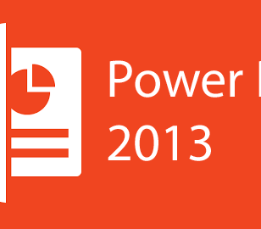
Creating an Effective Presentation
Designing your presentation is the fun part of creating a report fir it gives you a chance to be creative. Placing animations, transitions, and art could be on your mind right now. But whether or not these features would help is generally up to you. Sometimes, these things could actually distract your audience rather than help you. Here are some quick tips in creating an effective presentation:
.

Slide 3
Minimize
– keep slide counts to a minimum to maintain a clear message and to keep the audience attentive. Most information should still come from the reporter.
Clarity
– Avoid being fancy by using a font style that is easy to read. Make sure that it is also big enough to be read by the audience.
Simplicity
– Use bullets or short sentences. Summarize the information on the screen to have your audience focus on what the speaker is saying rather than on reading the slide. Limit the content to six lines and seven words per line.

Slide 4
Visuals
– Use graphics to help in your presentation but not too many to distract the audience. In addition, instead of using a table of data, use charts and graphs.
Consistency
– Make your design uniform. Avoid having different font styles and backgrounds.
Contrast
– Use light font on dark background or vice versa. This is done so that it is easier to read. In most instances, it is easier to read on screen if the background is dark. This is due to the brightness of the screen.

