Slide 1

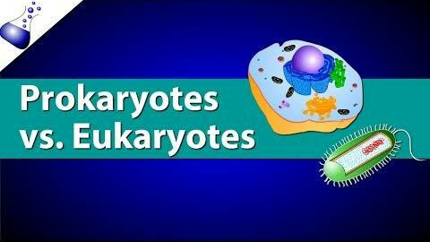
our office

Slide 2
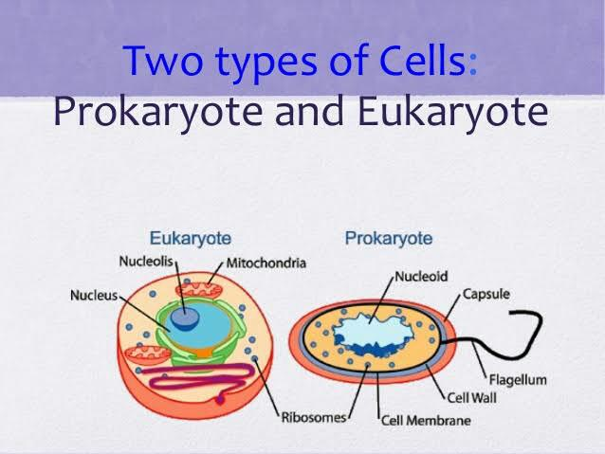
Two Types of Cell:
Eukaryotic Cell
Prokaryotic Cell

Slide 3
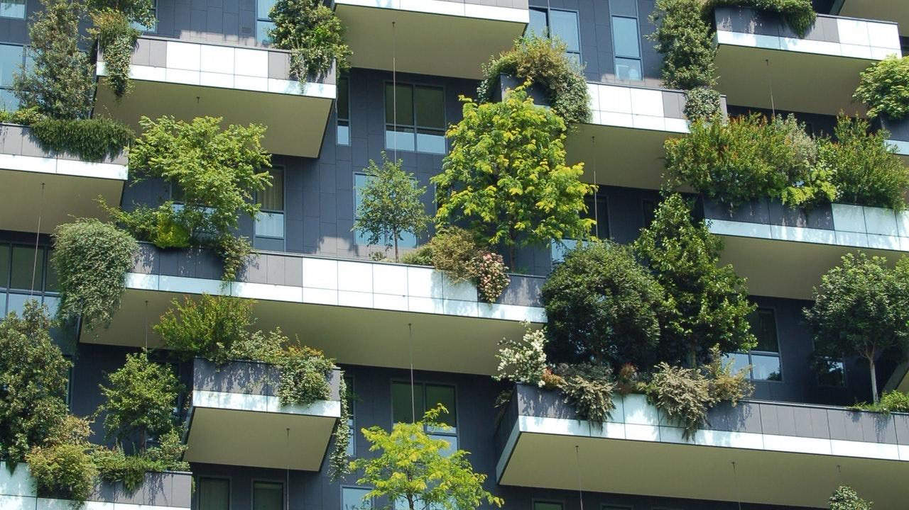
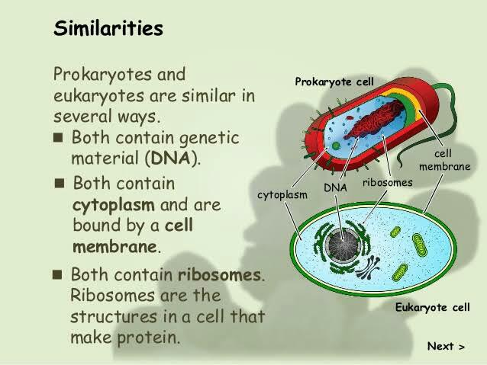
89,526,124$
100%
That’s a lot of money
And a lot of users
Total success!

Slide 4
DIFFERENCE OF EUKARYOTIC CELL AND PROKARYOTIC CELL

Slide 5
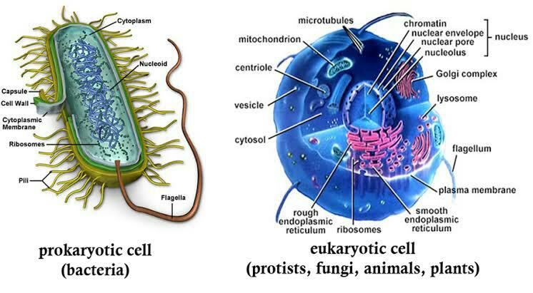
our office

Slide 6
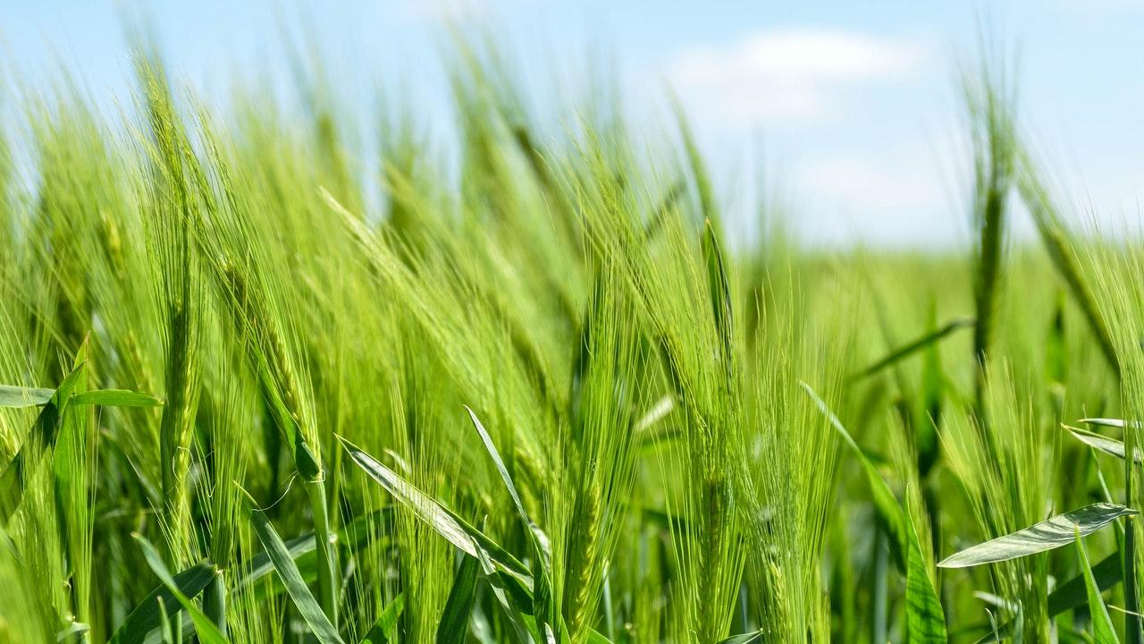
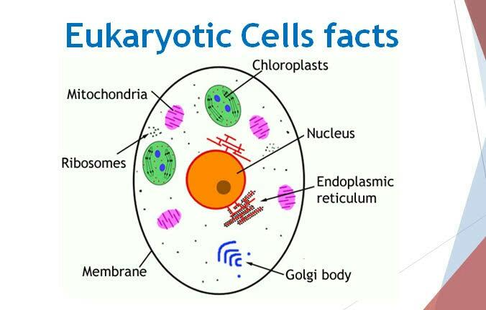
Our process is easy
Vestibulum congue tempus
Vestibulum congue tempus
03
01
02
Vestibulum congue tempus

Slide 7

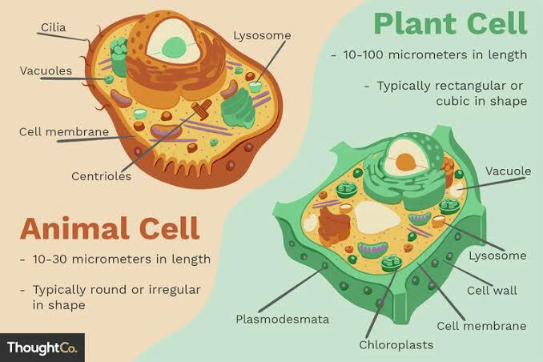
Two Types of Eukaryotic Cell:
Animal Cell
Plant Cell

Slide 8

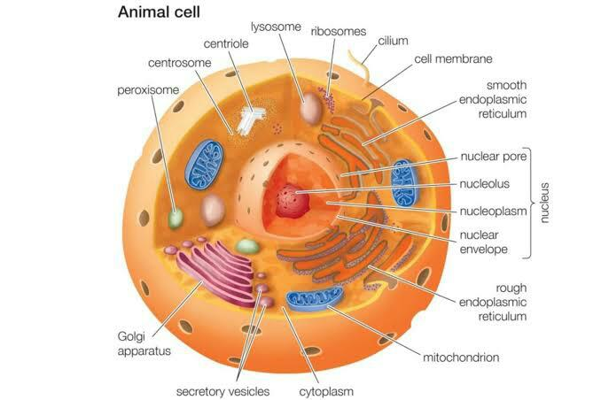
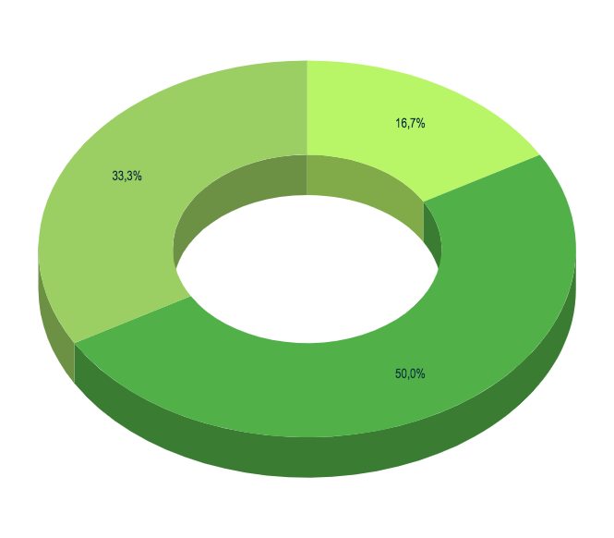
You can insert graphs from Google Sheets

Slide 9
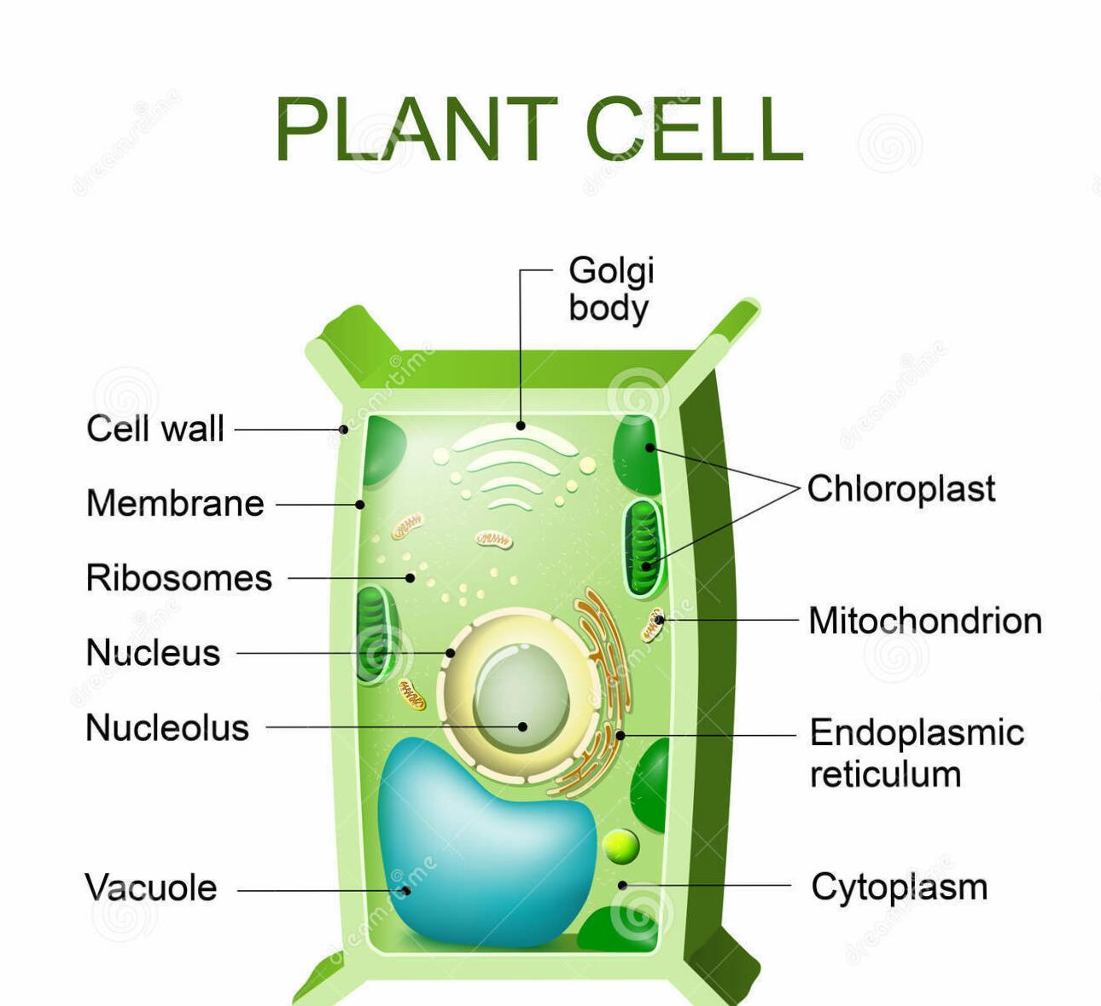
Android project
Show and explain your web, app or software projects using these gadget templates.
Place your screenshot here

Slide 10
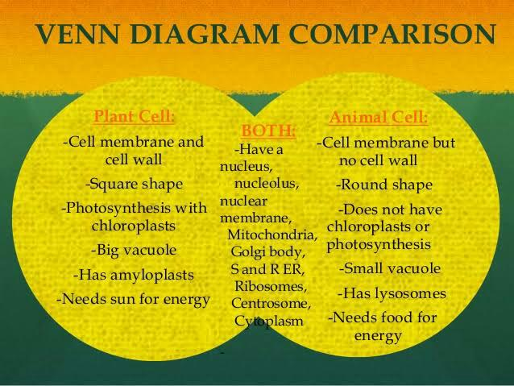
iPhone project
Show and explain your web, app or software projects using these gadget templates.
Place your screenshot here

Slide 11
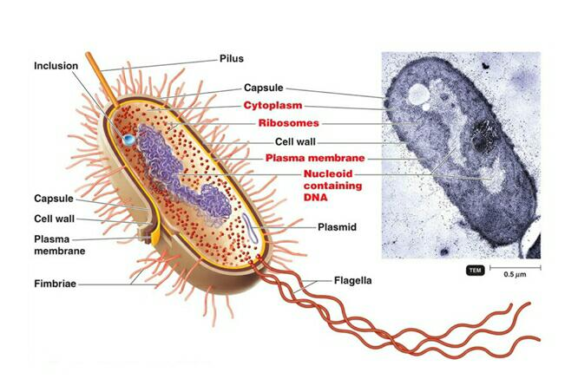
Prokaryotic Cell

Slide 12
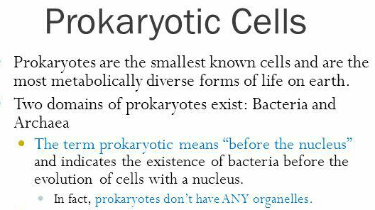
Place your screenshot here

Slide 14
Credits
Special thanks to all the people who made and released these awesome resources for free:
Presentation template by SlidesCarnival
Photographs by Unsplash

