Slide 1
Parts of the Cell

Slide 2
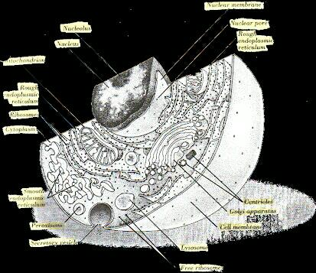

Slide 3
Human Cell
is an Animal Cell
It has a nucleus and it is enclosed by a nuclear membrane
Nuclear Membrane -sometimes referred to as the nuclear envelope, is the membrane that encloses the nucleus.

Slide 4
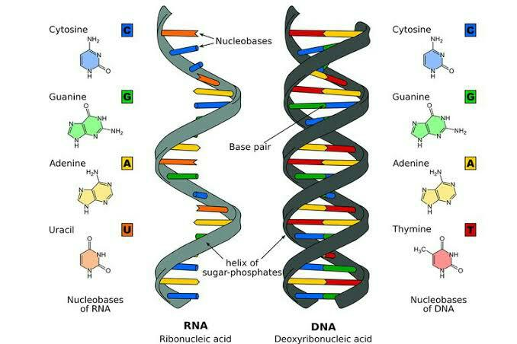
DNA and RNA
Both located in Nucleus

Slide 5
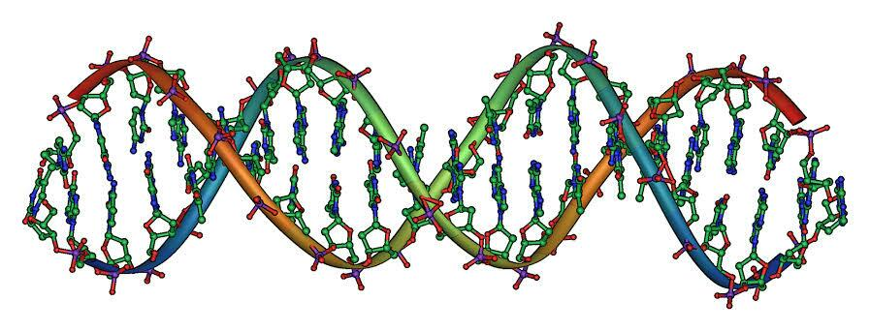
DNA
Deoxyribonucleic acid.
composed of two chains that coil around each other to form a double helix strand .
Creates a copy of messenger RNA (mRNA).

Slide 6
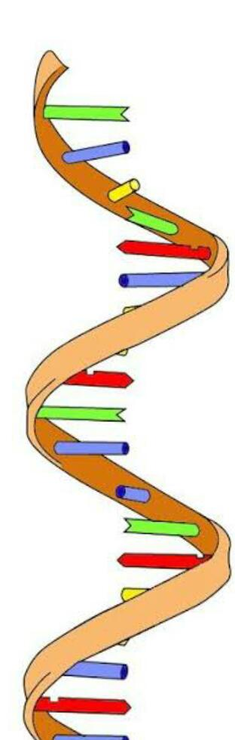
RNA
Ribonucleic acid.
Single Helix.
It a polymeric molecule essential in various biological roles in coding, decoding, regulation and expression of genes.

Slide 7
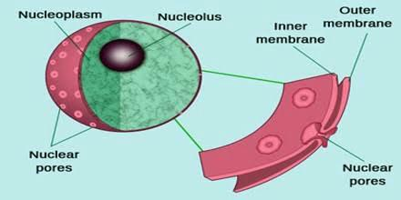
DNA and RNA are floating in a jelly-like fluid called Nucleoplasm

Slide 8
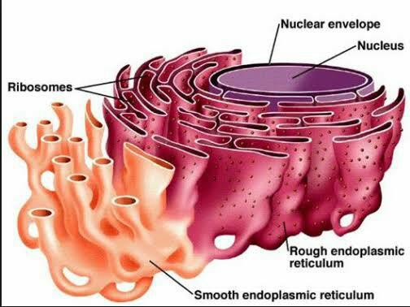
Rough Endoplasmic Reticulum (RER)
It is the 1st organelle that the mRNA will encounter after leaving the nucleus.
It is rough because of the Ribosomes.

Slide 9
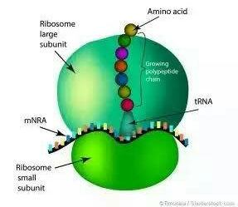
Ribosomes
Responsible for protein synthesis.
Contains amino acids.

Slide 10
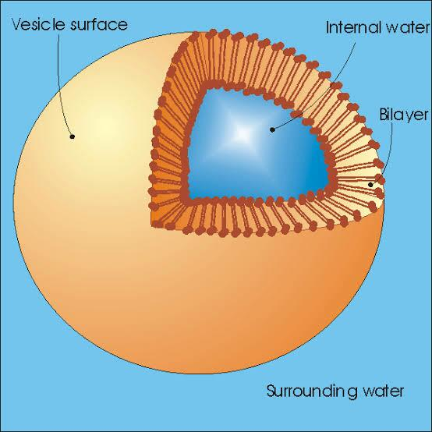
Vesicles
Storage of cellular molecules.
Made by RER through foldings called Cristae.

Slide 11

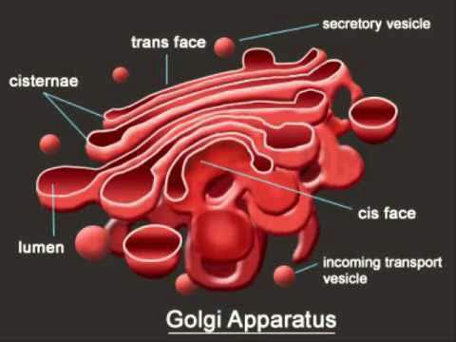
Golgi Apparatus
-Receives message and it transports organelles especially to the vesicles.
-After leaving Golgi Apparatus, vesicles will be transformed into different kinds and will go to Cytoplasm.

Slide 12
Cytoplasm
a thick solution that fills each cell and is enclosed by the cell membrane.
composed of water, salts, and proteins.
includes all of the material inside the cell and outside of the nucleus.

Slide 13
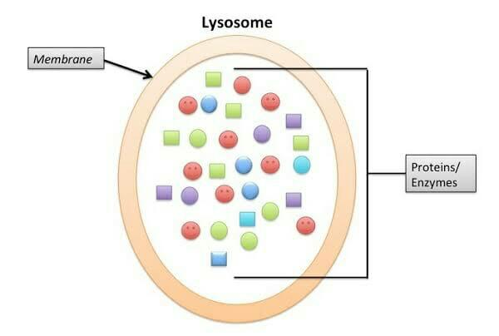
Lysosome
• Suicide bags or Suicide Sacks.
• For Garbage disposal.
• Has digestive enzymes.

Slide 14
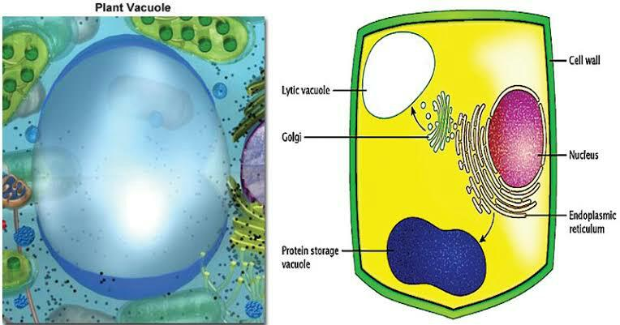
Vacuole
• Food storage of the cell.

