Slide 1
Hierarchical Organization of Life
Every level has an emerging property and every level is composed of the level below them.
START HERE
1
Notes:
Illustrated by freepik

Slide 2
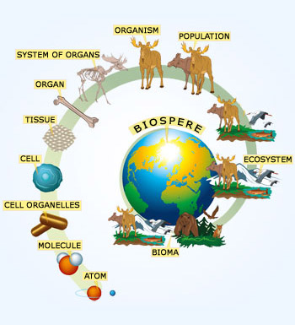
Atoms
Molecules
Macromolecules
Organelles
Cells
Tissue
Organs
Organ System
Organism
Population
Community
Ecosystem
Biosphere
2

Slide 3
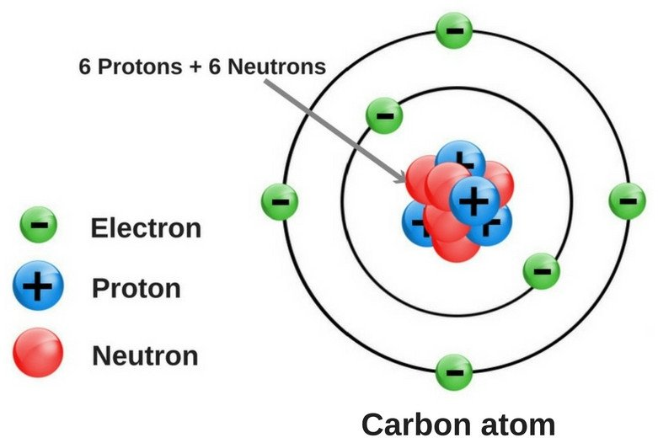
1. Atoms
Make up anything in this world (living thing or non-living thing).
Need to bond to another atom to become stable.
3

Slide 4
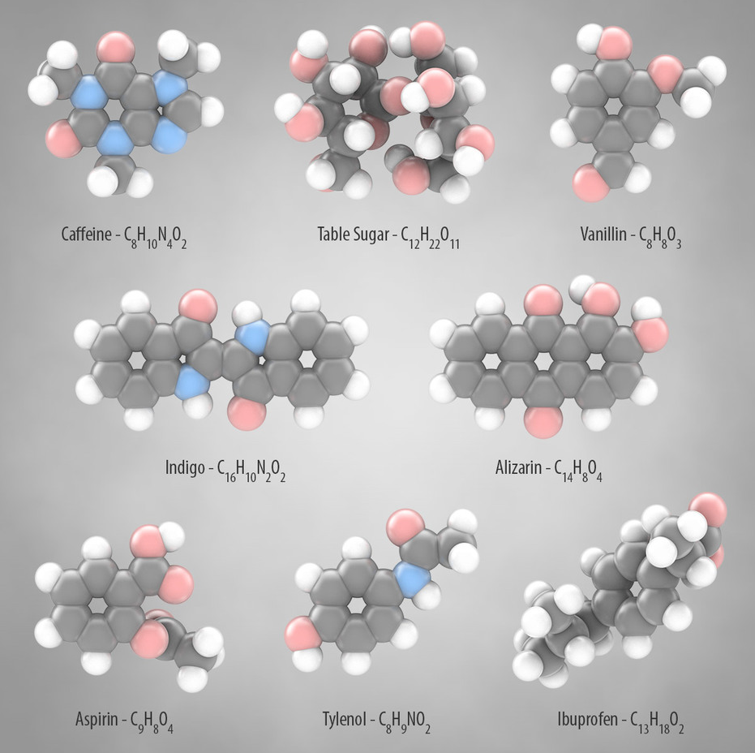
2. Molecules
Formed when atoms are combined together
* Both atoms and molecules are
invisible
4

Slide 5

3. Macromolecules
Visible
very large molecule, such as protein.
Synthetic macromolecules include common plastics and synthetic fibers as well as experimental materials such as carbon nanotubes.
5
Notes:
Illustrated by freepik

Slide 6
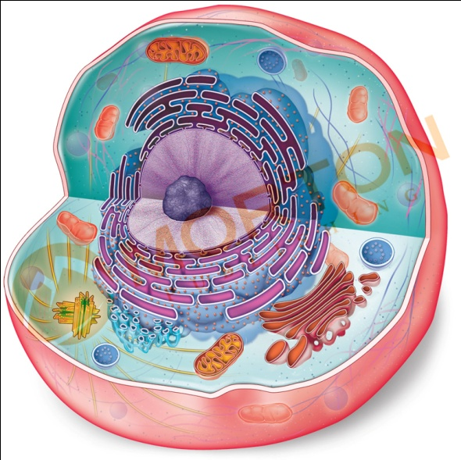
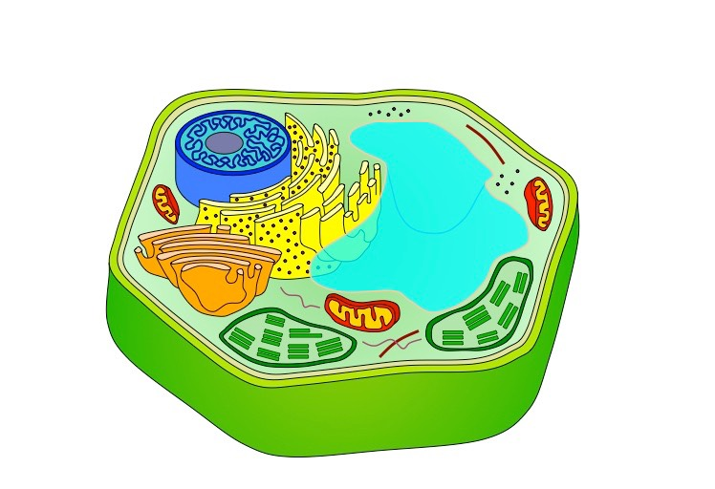
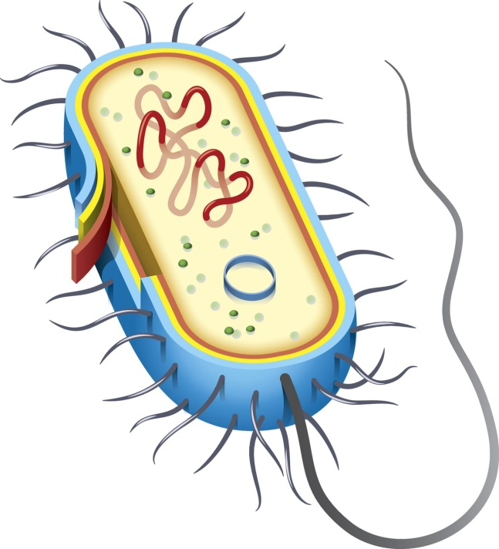
5. Cells
Types:
Basic unit of life
1. Epithelial Cells
2. Adipose Cells
Cells from pre-existing cells:
Classification:
Multicellular
Unicellular
Biogenesis
Abiogenesis
Notes:
Illustrated by freepik

Slide 7
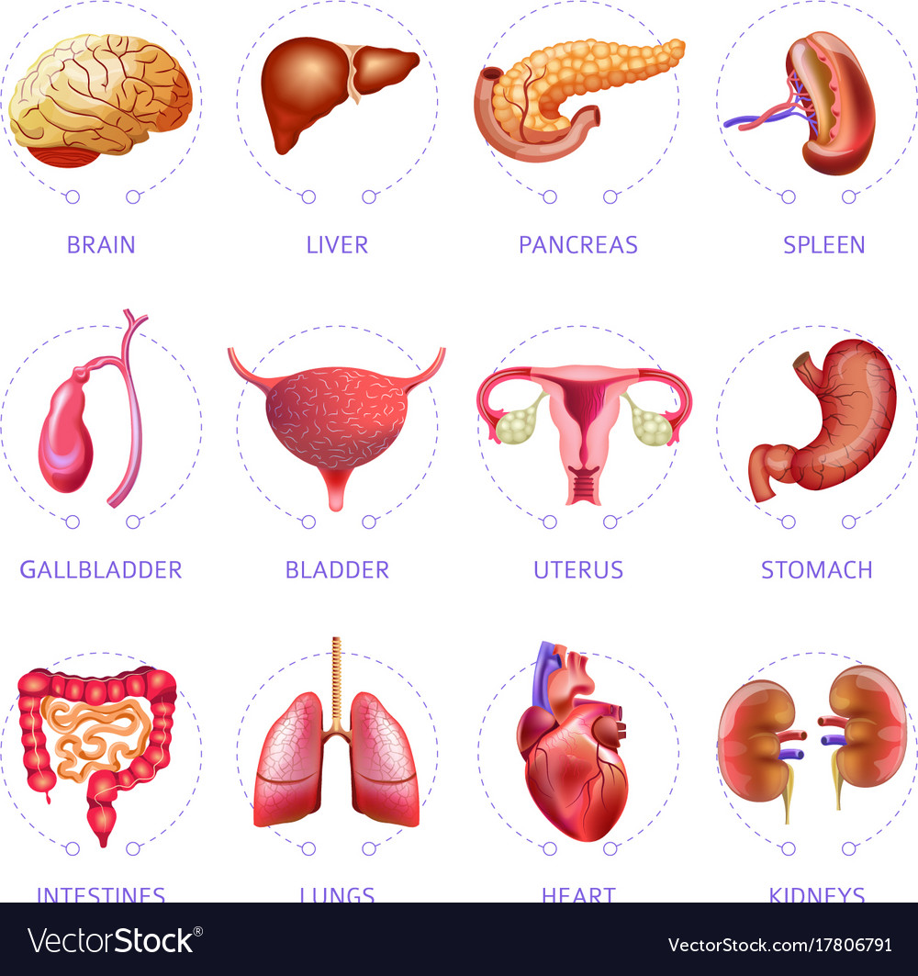




7. Organs
Make up the organ system.
Notes:
Illustrated by pikisuperstar

Slide 8
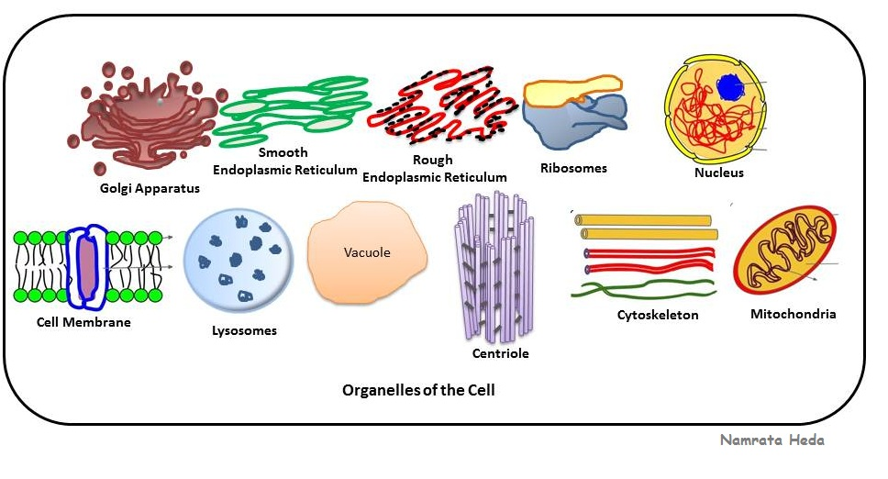


4. Organelles
Organs of the cell that keeps cell alive.
Gather informations from another cell.
Human or Organism: Organs
Cell: Organelles
Notes:
Illustrated by freepik

Slide 9

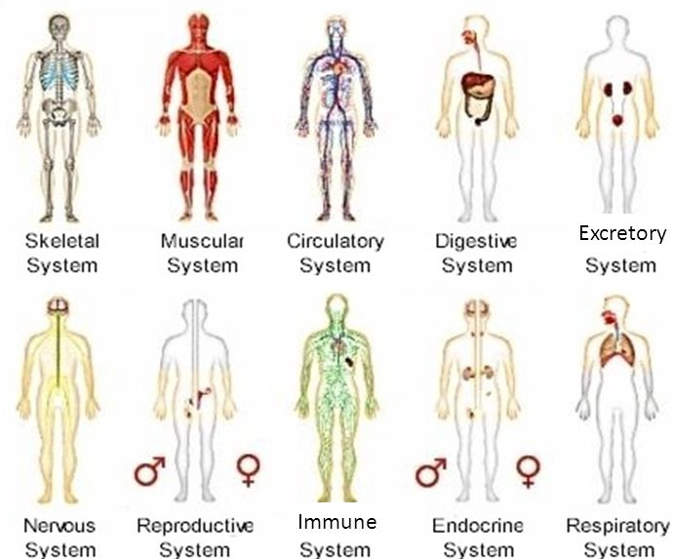
8. Organ System
It is a group of organs that work together as a biological system to perform one or more functions.
Notes:
Illustrated by pikisuperstar

Slide 10
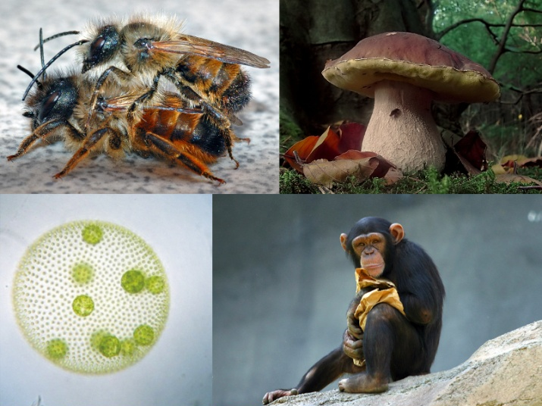


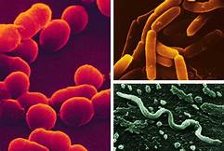


9. Organism
An organism can either be:
1. Eukaryotic
It is any individual entity that propagates the properties of life.
It is a synonym for “life form“.
2. Prokaryotic
Notes:
Illustrated by pikisuperstar

Slide 11
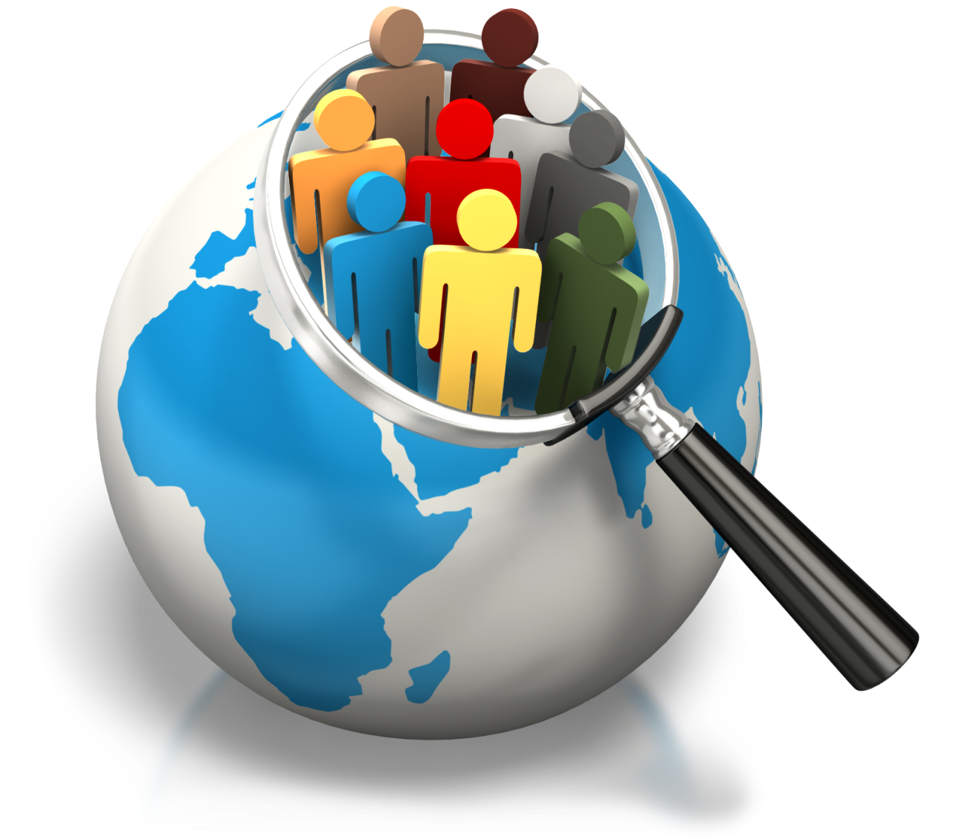



10. Population
Group of organisms that belong to the same specie.
Notes:
Illustrated by pikisuperstar

Slide 12



11. Community
Species that live within the same area.
Notes:
Illustrated by pikisuperstar
Character design by Freepik

Slide 13
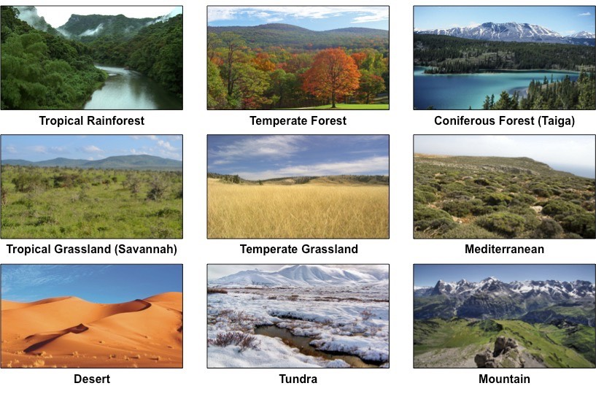
12. Ecosystem
is a community of living organisms in conjunction with the nonliving of their environment, interacting as a system.
Examples:
Notes:
Illustrated by freepik

Slide 14
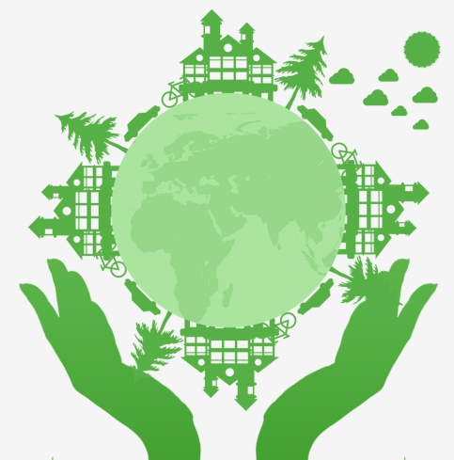
13. Biosphere
It is also known as the ecosphere
biospheres are any closed, self- regulating systems containing ecosystems.
Example: Earth
END
14

