Slide 1
ADVANCED SPREADSHEET SKILLS

Slide 2

Whether you wirk in the field of accounting or not, the truth is whatever you do should be accounted for. This is because the resources you use cost you expenses. Whether you become a scientist, an engineer, a yoga instructor, etc. it is important ti understand how a company spends to be able to deliver a product or service. These factors could be easily be computed using spreadsheet programs like MS Excel or Google Spreadsheets.
Place your screenshot here

Slide 3

Using the SUM Command
If you need to sum a column or row of numbers, let Excel do the math for you. Select a cell next to the numbers you want to sum, click AutoSum on the Home tab, press Enter, and you’re done.
When you click AutoSum, Excel automatically enters a formula (that uses the SUM function) to sum the numbers.

Slide 4
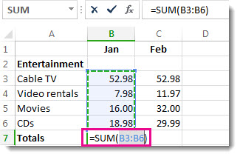
When you click AutoSum, Excel automatically enters a formula (that uses the SUM function) to sum the numbers.
Here’s an example. To add the January numbers in this Entertainment budget, select cell B7, the cell immediately below the column of numbers. Then click AutoSum. A formula appears in cell B7, and Excel highlights the cells you’re totaling.

Slide 5
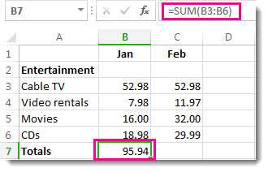
Press Enter to display the result (95.94) in cell B7. You can also see the formula in the formula bar at the top of the Excel window.

Slide 6
Using the AVERAGE Command
The Microsoft Excel AVERAGE function returns the average (arithmetic mean) of the numbers provided.
The AVERAGE function is a built-in function in Excel that is categorized as a Statistical Function. It can be used as a worksheet function (WS) in Excel. As a worksheet function, the AVERAGE function can be entered as part of a formula in a cell of a worksheet.
Syntax
The syntax for the AVERAGE function in Microsoft Excel is:
AVERAGE (number1, [number 2],…. [number_n] )

Slide 7
Parameters or Arguments
number1, number2, … number_n
Numeric values that can be numbers, named ranges, arrays, or references to numbers. There can be up to 30 values entered.
Example (as Worksheet Function)
Let’s look at some Excel AVERAGE function examples and explore how to use the AVERAGE function as a worksheet function in Microsoft Excel:
COUNT FUNCTION Applies To: Excel 2016 Excel 2013 Excel 2010 Excel 2007 Excel 2016 for Mac More…
The COUNT function counts the number of cells that contain numbers, and counts numbers within the list of arguments. Use the COUNT function to get the number of entries in a number field that is in a range or array of numbers. For example, you can enter the following formula to count the numbers in the range A1:A20: =COUNT(A1:A20). In this example, if five of the cells in the range contain numbers, the result is 5.

Slide 8
Syntax
COUNT(value1, [value2], …)
The COUNT function syntax has the following arguments:
value1 Required. The first item, cell reference, or range within which you want to count numbers.
value2, … Optional. Up to 255 additional items, cell references, or ranges within which you want to count numbers.
NOTE: The arguments can contain or refer to a variety of different types of data, but only numbers are counted.

Slide 9
Remarks
Arguments that are numbers, dates, or a text representation of numbers (for example, a number enclosed in quotation marks, such as “1”) are counted.
Logical values and text representations of numbers that you type directly into the list of arguments are counted.
Arguments that are error values or text that cannot be translated into numbers are not counted.
If an argument is an array or reference, only numbers in that array or reference are counted. Empty cells, logical values, text, or error values in the array or reference are not counted.
If you want to count logical values, text, or error values, use the COUNTA function.
If you want to count only numbers that meet certain criteria, use the COUNTIF function or the COUNTIFS function.
sources:

Slide 10
INSTRUCTIONS FOR USE
EDIT IN GOOGLE SLIDES
Click on the button under the presentation preview that says "Use as Google Slides Theme".
You will get a copy of this document on your Google Drive and will be able to edit, add or delete slides.
You have to be signed in to your Google account.
EDIT IN POWERPOINT®
Click on the button under the presentation preview that says "Download as PowerPoint template". You will get a .pptx file that you can edit in PowerPoint.
Remember to download and install the fonts used in this presentation (you’ll find the links to the font files needed in the Presentation design slide)
More info on how to use this template at www.slidescarnival.com/help-use-presentation-template
This template is free to use under Creative Commons Attribution license. You can keep the Credits slide or mention SlidesCarnival and other resources used in a slide footer.

