Slide 1
MINERALS

Slide 2
MINERALS
Naturally occurring, inorganic solid with orderly crystalline structure and a definite chemical composition.
Basic building blocks of rocks.
Examples:
salt, graphite, diamond, and gold.

Slide 3
PROPERTIES OF MINERALS

Slide 4
1. LUSTER

Slide 5
Is used to describe how light is reflected from the surface of a mineral.

Slide 6
Classified into two:
Metallic
Generally opaque, exhibits shine similar to a polished metal.
Non-metallic
vitreous(glasy); adamantine (diamond-like); resinous, silky, pearly, dull(earthy), greasy.

Slide 7
2. HARDNESS

Slide 8
Is a measure of the resistance of a mineral to being scratched.

Slide 9
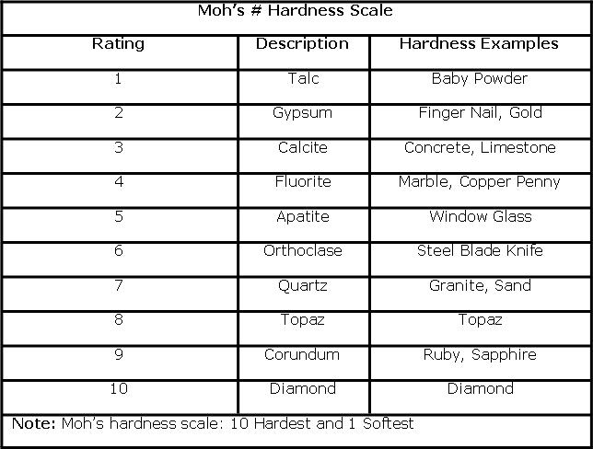
MOHS SCALE OF HARDNESS
Mohs Scale
Consists of 10 mineral arranged from 10(hardest) to 1(softest).

Slide 10
3. COLOR

Slide 11
Maybe a unique identifying property of certain minerals.
Small amounts of different elements can give the same mineral different colors.
Example: Quartz (pink-rose quartz, purple-amethyst, orange citrine, white-colorless quartz)

Slide 12
4. STREAK

Slide 13
Is the color of a mineral in its powdered form.
Is inherent to almost every mineral.
A better diagnostic property arranged to color due to impurities that causes interferences.

Slide 14
5. CRYSTAL FORM

Slide 15
Is the visible expression of a mineral’s internal arrangement of atoms.
External shape of a crystal/group of crystals is displayed or observed in open spaces.
The form reflects the supposedly internal structure of the crystal.
Examples: Prismatic, tabular, bladed, platy.

Slide 16
6. CLEAVAGE

Slide 17
Is the tendency of a mineral to cleave, or break, along flat, even surfaces.
“Plates of weakness” which are inherent in the bonding of atoms that makes up the material.

Slide 18
7. FRACTURE

Slide 19
Minerals that do not show cleavage when broken are said to fracture.
Fracture the uneven breakage of a mineral.
Example: conchoidal, fibrous and hackly.

Slide 20
8. DENSITY

Slide 21
Numerically equal to specific Gravity(SG)
Density is a property of all matter that is the ratio of an object’s mass to its volume.
Based on a bucket of AG(SG10), which weighs 10x more than a bucket of water (SG1).

Slide 22
9. DISTINCTIVE PROPERTIES OF METALS

Slide 23
Some minerals can be recognized by other distinctive properties.

Slide 24
MINERAL GROUPS

Slide 25
1. SILICATES

Slide 26
Silicons and oxygen combine to form a structure called the silicon-oxygen tetrahedron. This silicon-oxygen tetrahedron provides the framework of every silicate mineral.

Slide 27
2. CARBONATES

Slide 28
Minerals that contain the elements carbon, oxygen and one or more other metallic elements.

Slide 29
3. OXIDES

Slide 30
Minerals that contain oxygen and one or more other elements, which are usually metals.

Slide 31
4. SULFATES AND SULFIDES

Slide 32
Minerals that contain the element sulfur.

Slide 33
5. HALIDES

Slide 34
Minerals that contain a halogen ion plus one or more other element.

Slide 35
6. NATIVE ELEMENTS

Slide 36
Minerals that exist in relativity pure form.

Slide 37
Thanks!
Any questions?
EDUCADEMY

